Slide 1


Your name

Slide 2
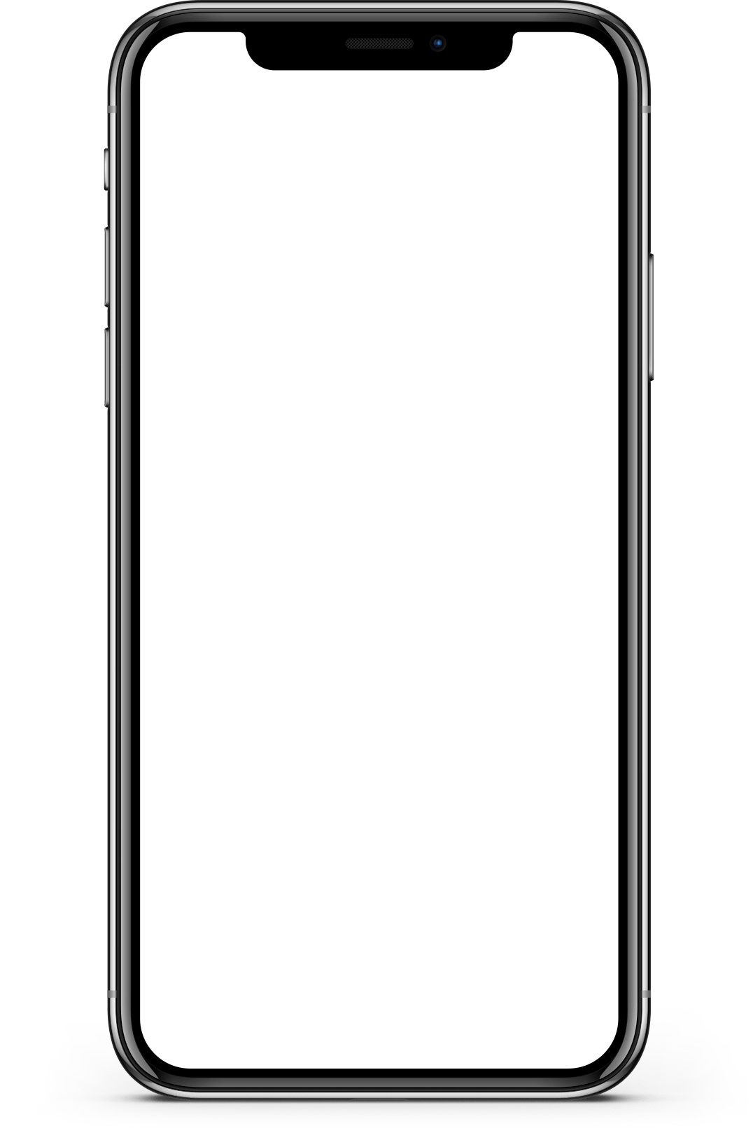
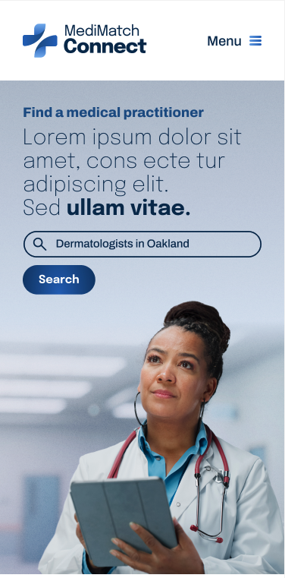
Project overview
The product:
A healthcare-informed booking assistant platform for all health and wellness needs
Project duration:
11 weeks

Slide 3
Project overview
The problem:
Users need a way to use a health assistant to provide tailored research for their specific health needs. This is because they are busy and often struggle using their health insurance’s web portal to find a health practitioner and schedule an appointment.
The goal:
To give people a simple, customized, and intuitive way to book with health practitioners in nearly any field quickly by using an informed health assistant.

Slide 4
Project overview
My role:
This is an individual project that allowed me to plan and direct each step of the design thinking process as a UX design student with mobile and web UI design experience.
Responsibilities:
Conduct user research
Define the problem and provided insights to inform the ideation phase
Define personas, user journeys, empathy maps and user flows
Visual design of low-fi and high-fi wireframes, prototypes, and user testing

Slide 5
User research
Personas
Problem statements
User journey maps
Understanding
the user

Slide 6
User research: summary
To understand user frustration, needs, and requirements, I conducted user research through interviews and user surveys for my project. My goal was to gain insights into the needs and wants of users so that I can better design my app and responsive website.
There are two types of user research methodologies: qualitative and quantitative research. I chose qualitative research because I had a time constraint.

Slide 7
User research: pain points
1
2
3
4
Pain point
Pain point
Pain point
Pain point
Finding an experienced doctor is time-consuming.
Users wants to make their health a priority and keep up with their regular appointments, but they’re unable to do so with their busy schedule.
For some users, it’s embarrassing to ask certain health questions over the phone and they would prefer to book appointments through an app to help them feel more at ease.
Users need a way to submit what they are looking for in a health practitioner, have someone do the research and make the appointments for them.
Not being able to access and manage medical records and history is also frustrating for users.
They also struggle with insufficient options for follow-up care and monitoring.

Slide 8
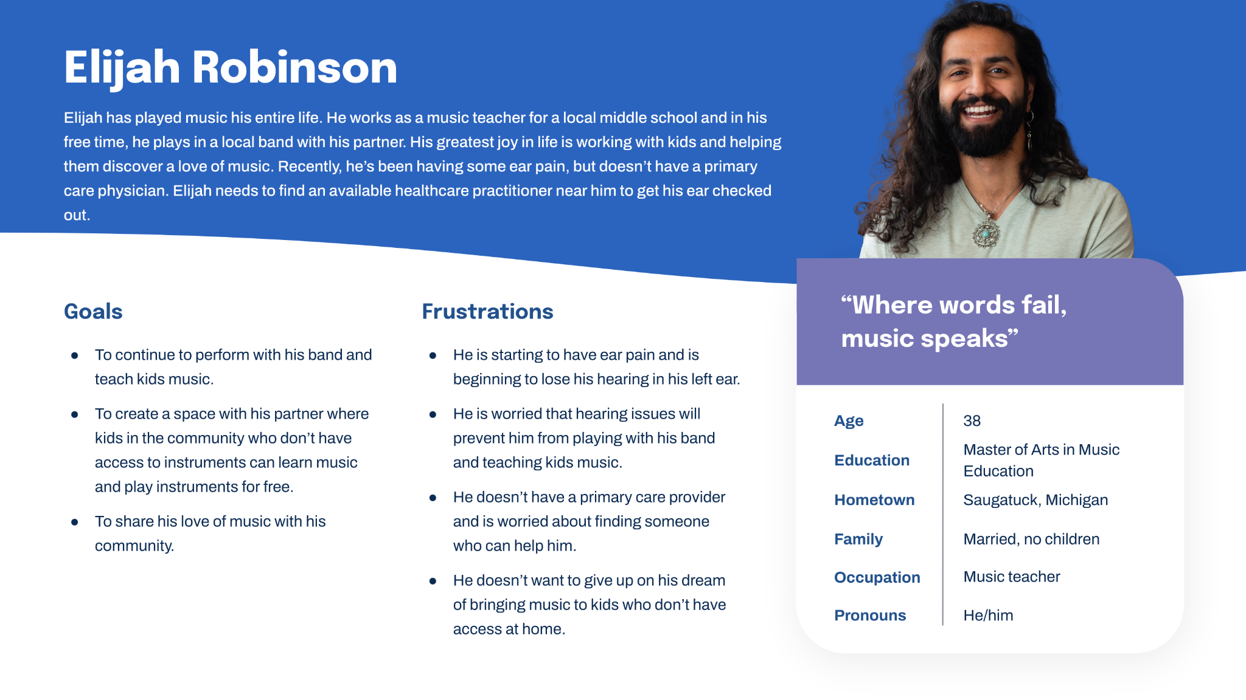
Persona: Elijah
Problem statement:
Elijah is a musician and music teacher who needs to book a doctor’s appointment because he has a health concern about his ears.

Slide 9
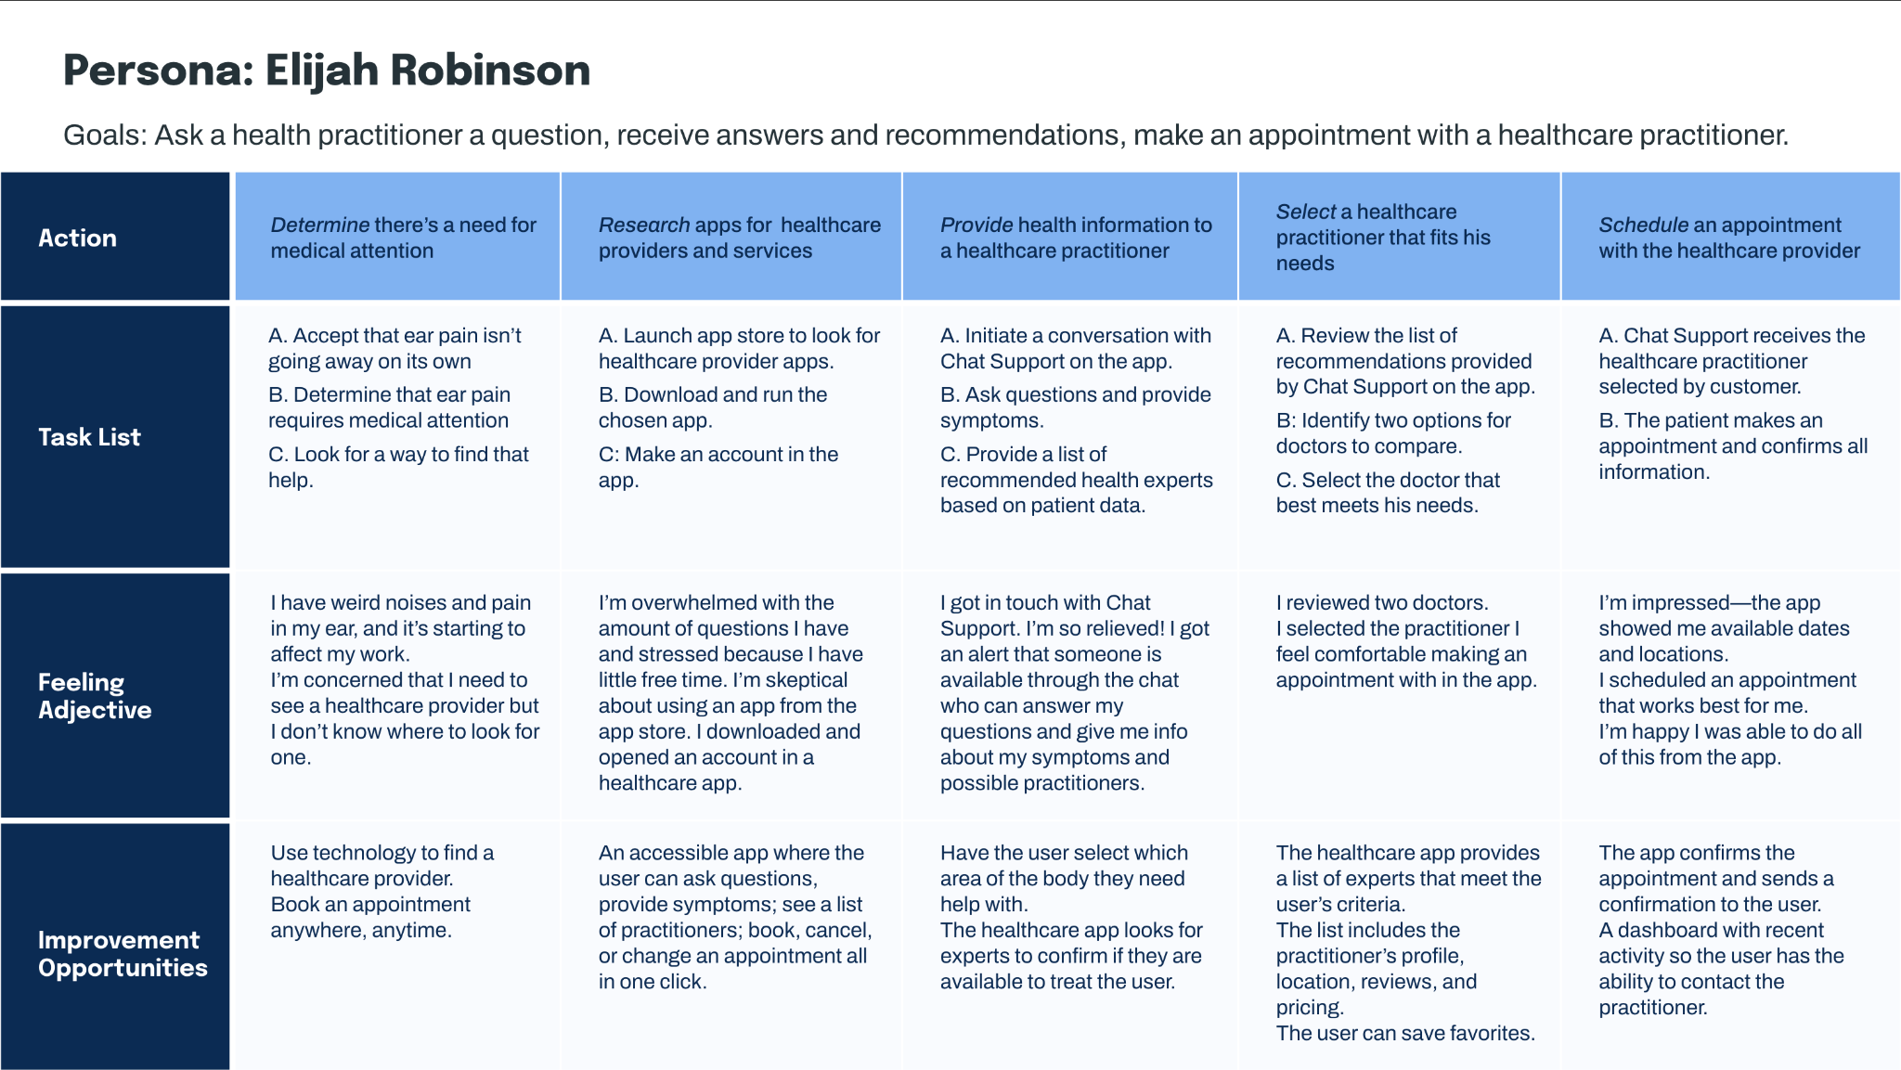
User journey map
By creating user journey maps, I wanted to illustrate the process of how Elijah behaves, feels, and what he thinks while accomplishing his goals to address pain points or provide moments of delight.

Slide 10
Sitemap
Paper wireframes
Digital wireframes
Low-fidelity prototype
Usability studies
Starting
the design

Slide 11
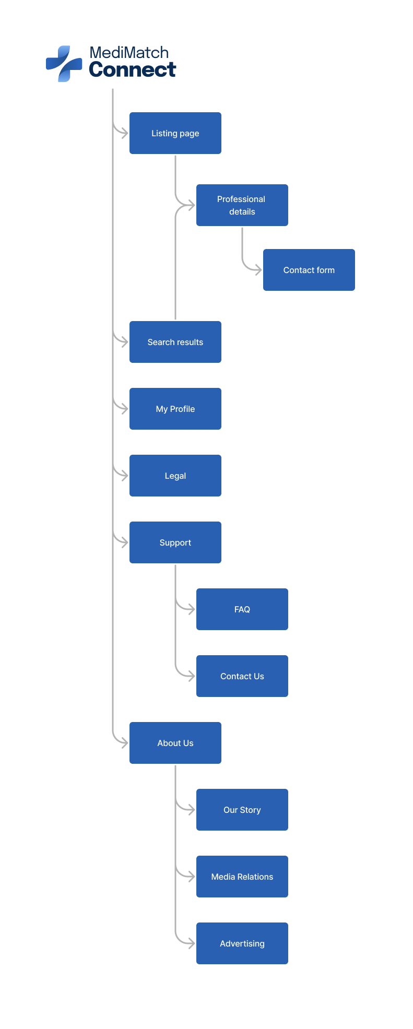
Sitemap
I built user-focused flows to ensure that my personas could successfully complete their key objectives while reducing any existing pain points.
To view a larger version of this sitemap, follow the link here.
Image of sitemap/IA
These will be added

Slide 12
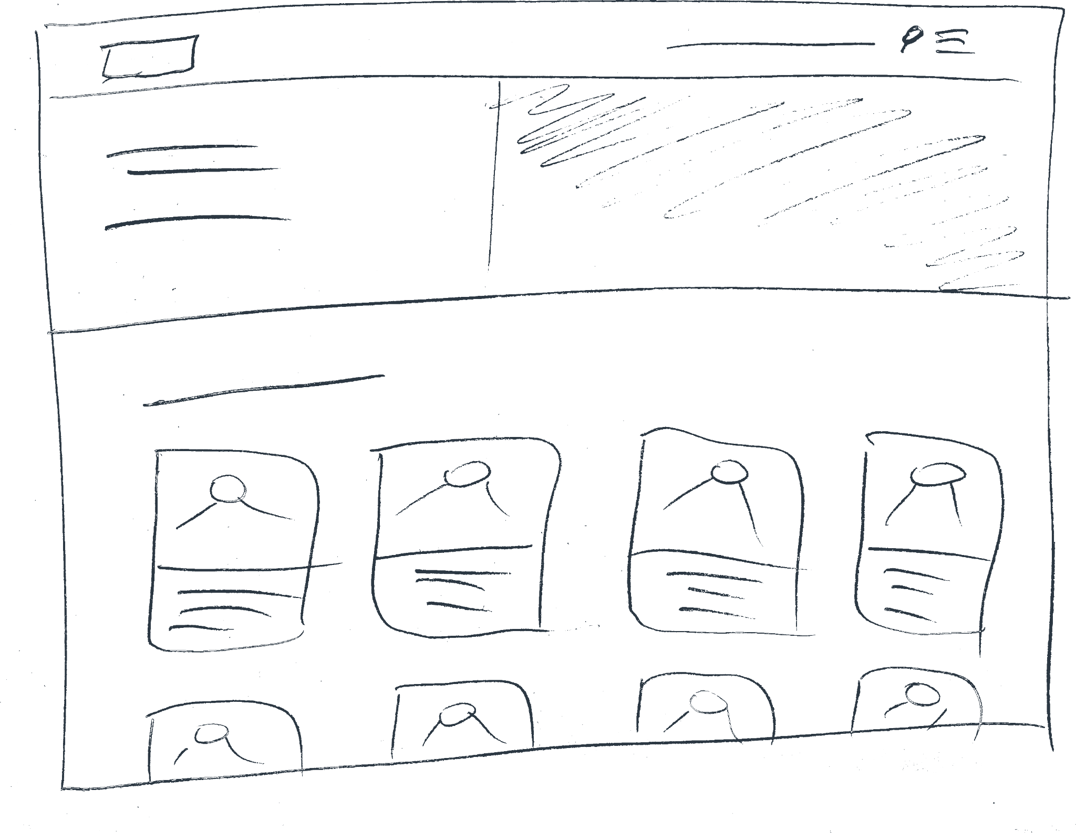
Paper wireframes
Focusing on the core features identified during user research, I sketched the first wireframes using pen and paper.

Slide 13
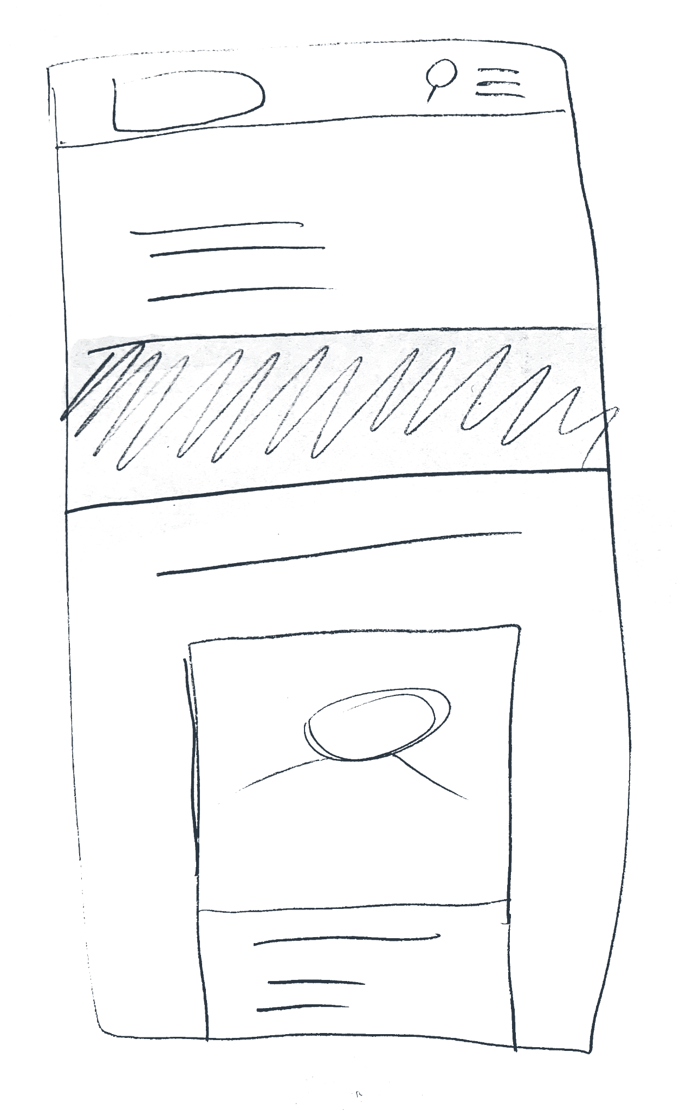
Paper wireframe
screen size variations
I drafted iterations of each screen on paper.
I also started to work on designs for additional screen sizes to make sure the site would be fully responsive.

Slide 14
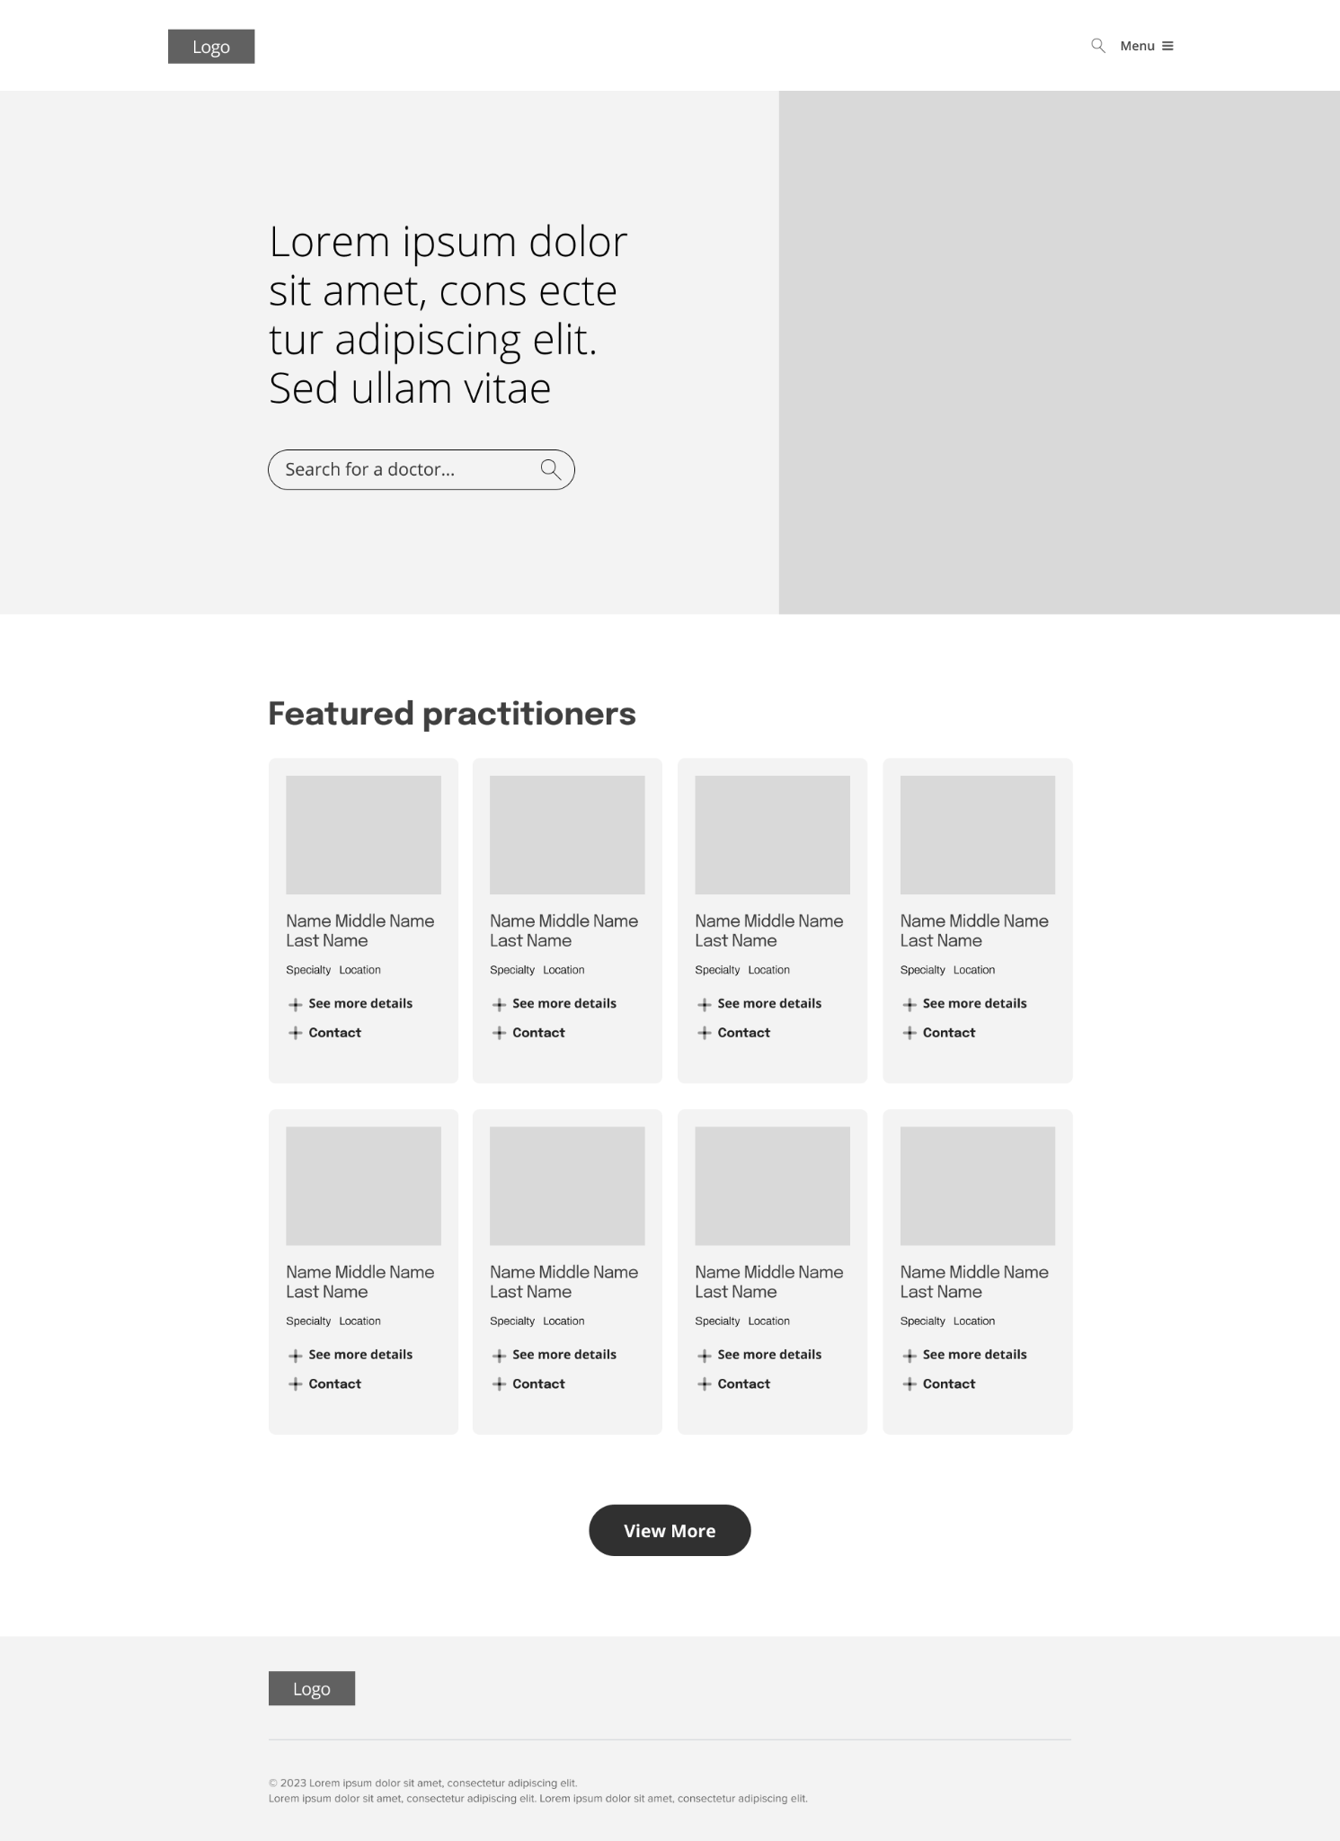
Digital wireframes
Prioritizing the practitioners search on the homepage over the fold is optimized for easy browsing
To make the digital wireframes, I started by putting my ideas on paper. Then I began to work on the high-fidelity wireframes in Figma. After several iterations, I came up with these wireframes.
Easy access to practitioners info preview

Slide 15
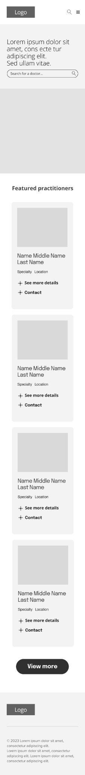
Digital wireframe
screen size variation(s)
I also started to work on digital wireframes for additional screen sizes to make sure the site would be fully responsive.

Slide 16
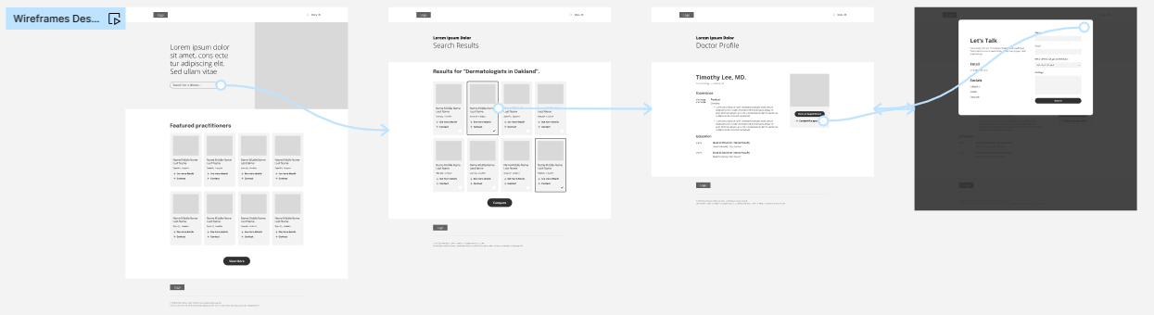
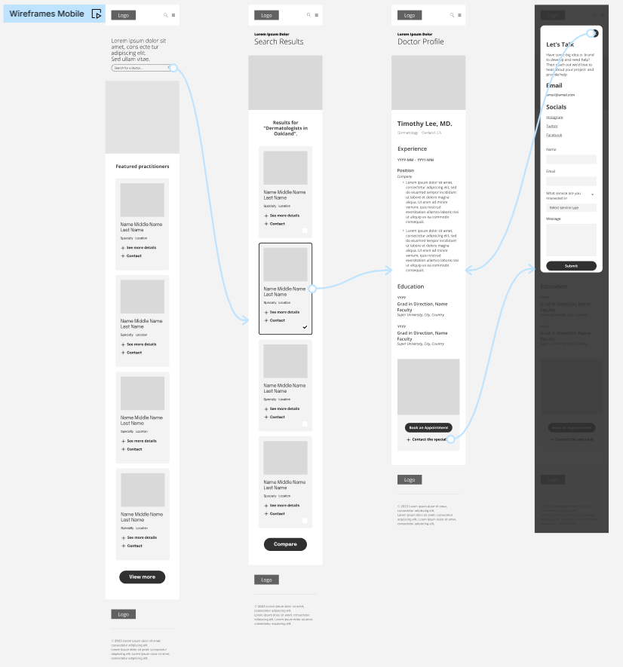
Low-fidelity prototype
I created a low-fidelity prototype from the user flow diagram and wireframes to test functionality before incorporating it into the final design and to ensure accessibility for end-users.
View Prototype:
Desktop
Mobile

Slide 17
Usability study: parameters
Study type:
Unmoderated usability study
Location:
United States, remote
Participants:
5 participants
Length:
20-30 minutes

Slide 18
Usability study: findings
Now that I have the key insights from the usability study, let's look at the findings and define the actual problems that a designer can solve.
1
2
3
Finding
Finding
Finding
Doctor profile screen: needs to provide more details for users to make
an informed choice between doctors.
Details missing:
type of insurance accepted, price of treatment, languages spoken, and recommended
type of appointment (in-office or virtual).
Search doctors list view: users tried to look for doctors who accepted their insurance or based on their gender preference, but the app did not have filtering.
Details missing:
Filter capability
Users tried to look for highly recommended doctors, but the app didn’t have that information.
Details missing:
Valid user recommendations about the health expert

Slide 19
Refining
the design
Mockups
High-fidelity prototype
Accessibility

Slide 20
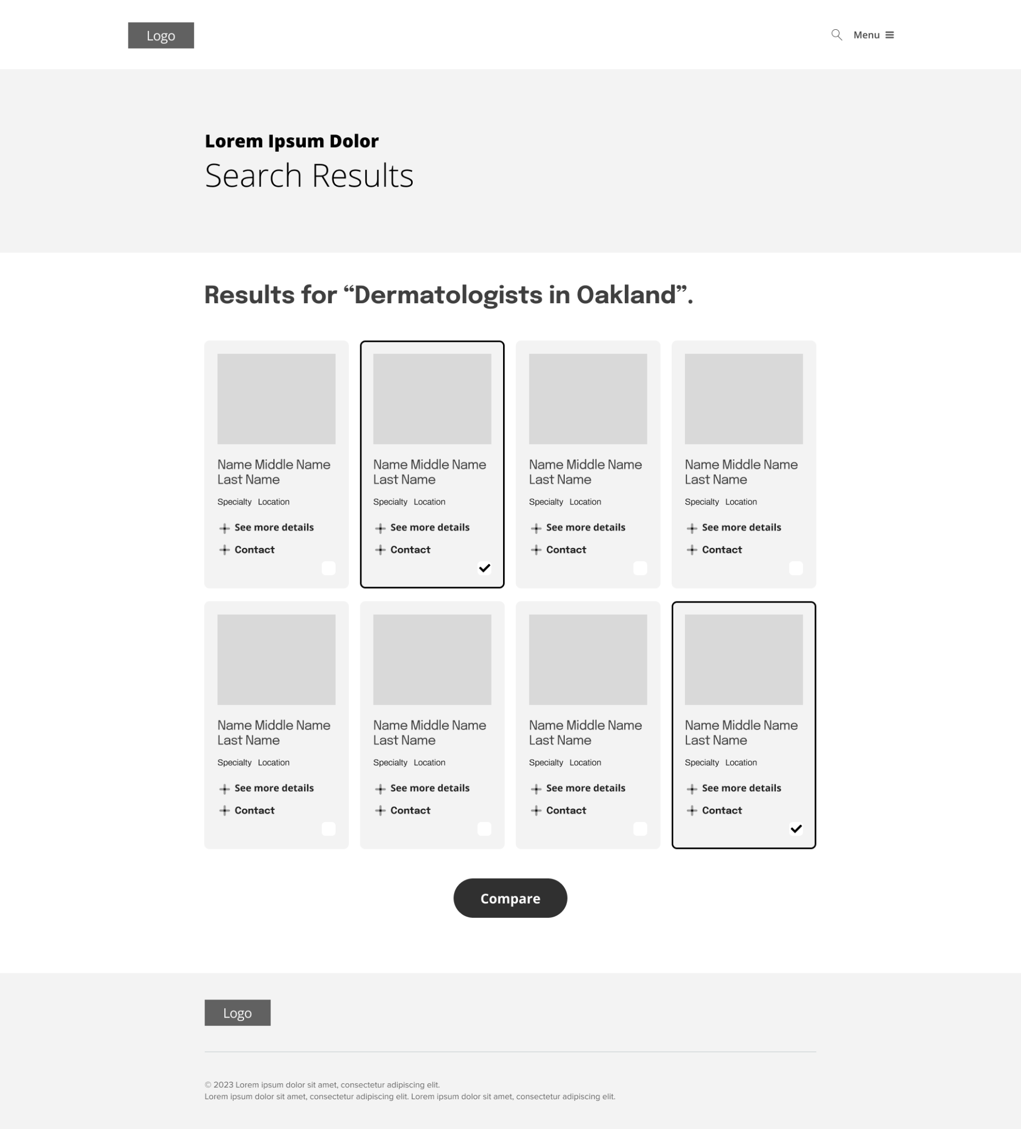
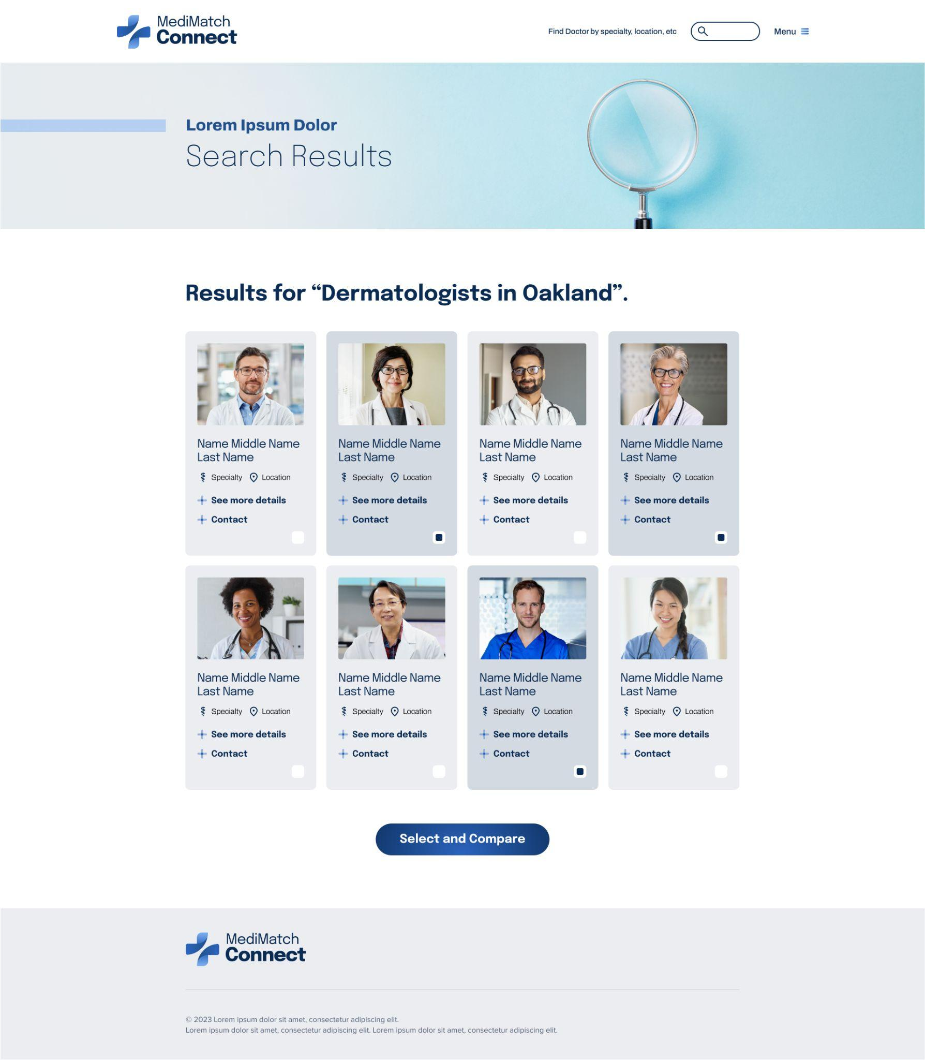
Mockups
Based on insights from the usability studies, I applied design changes. These include adding more information on the practitioner profile and patient reviews.
Before usability study
After usability study

Slide 21
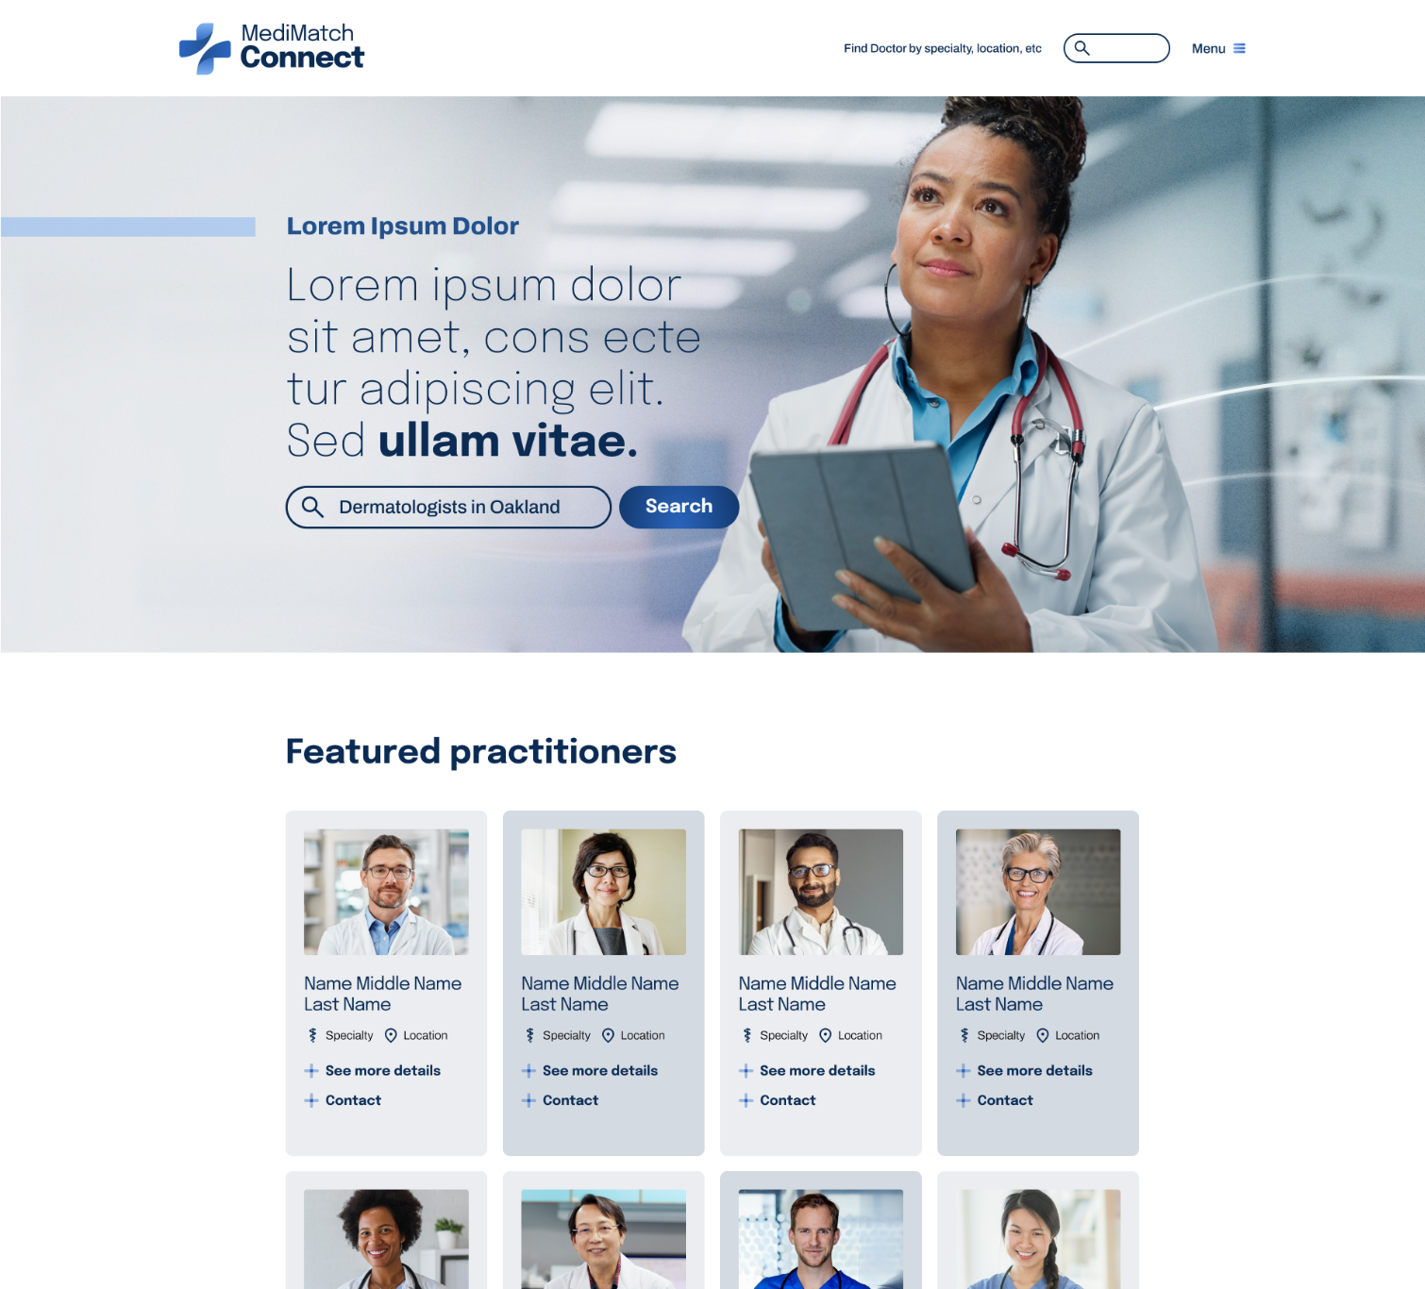
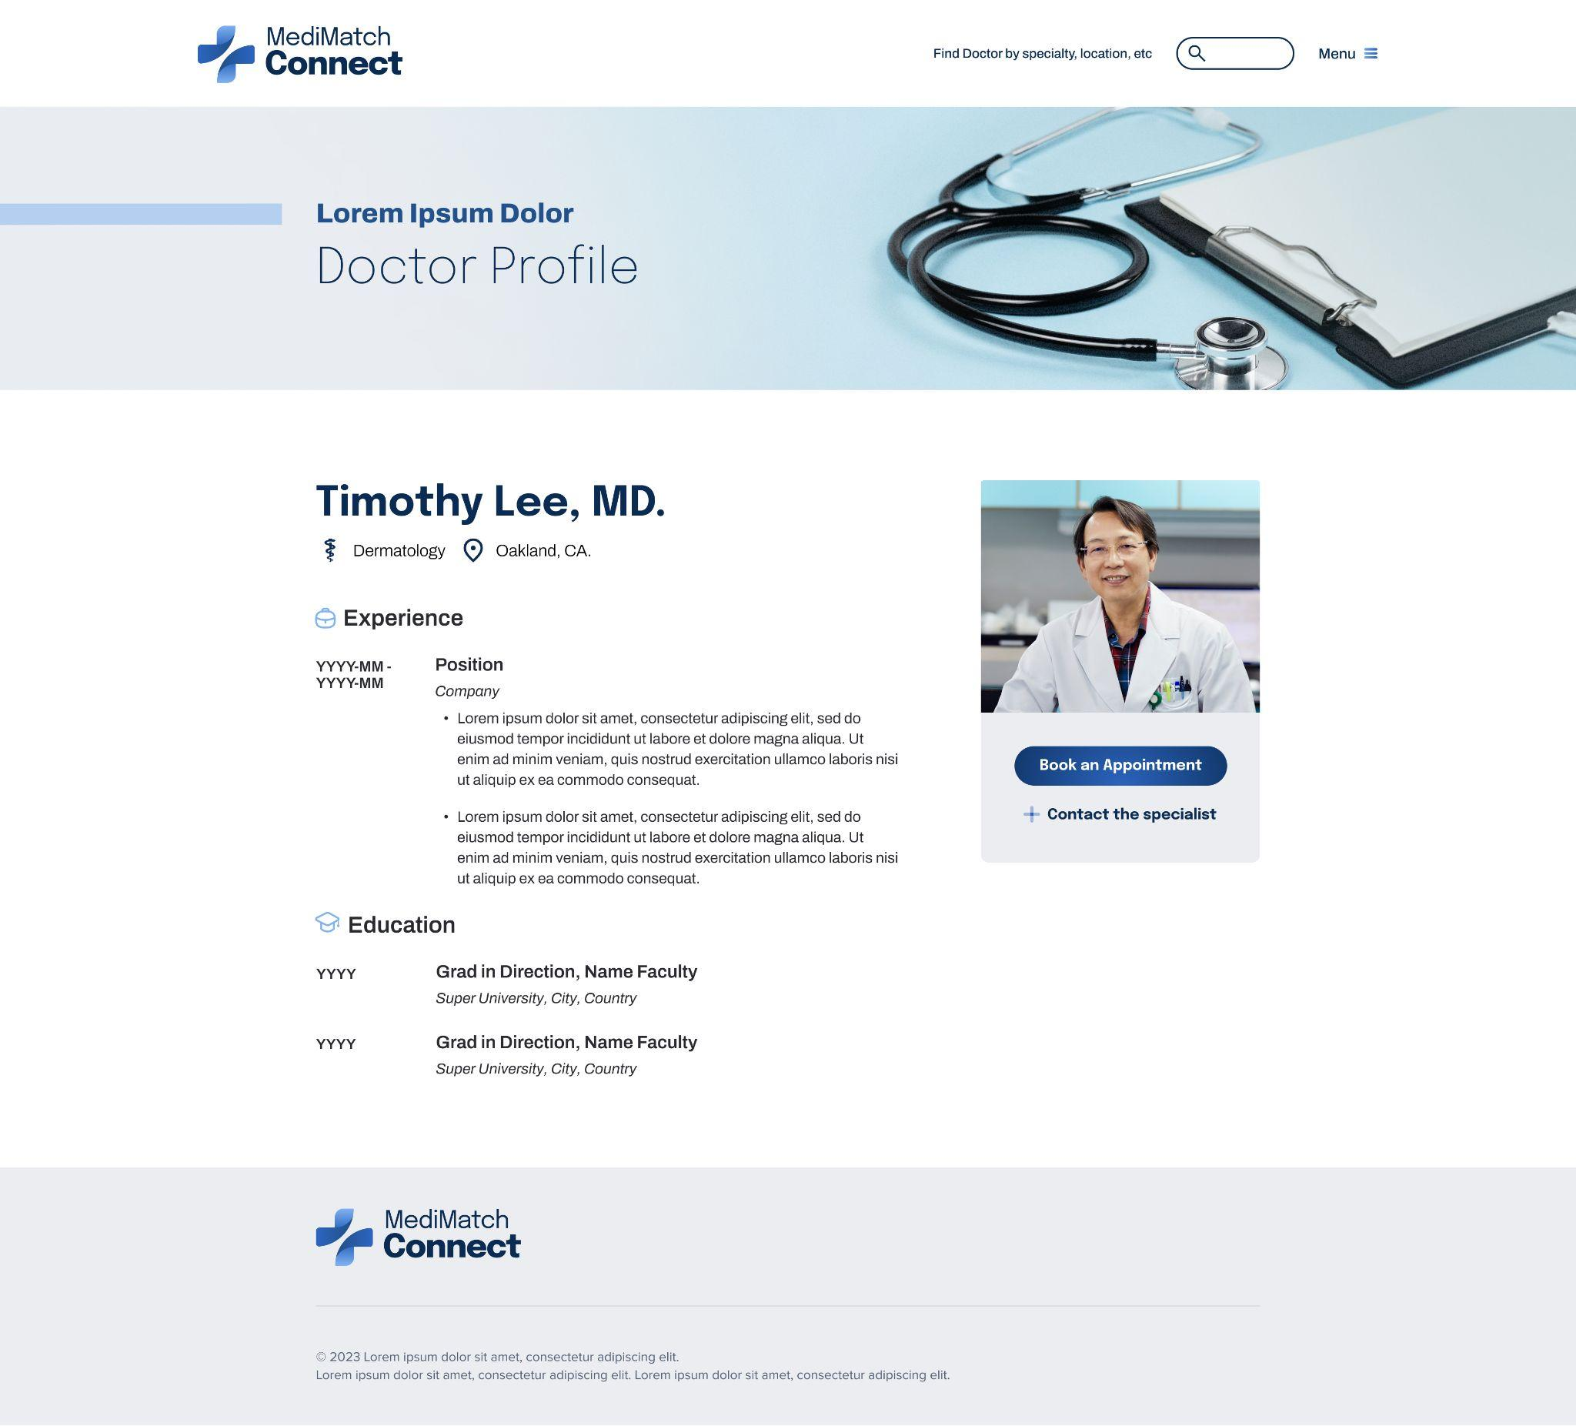
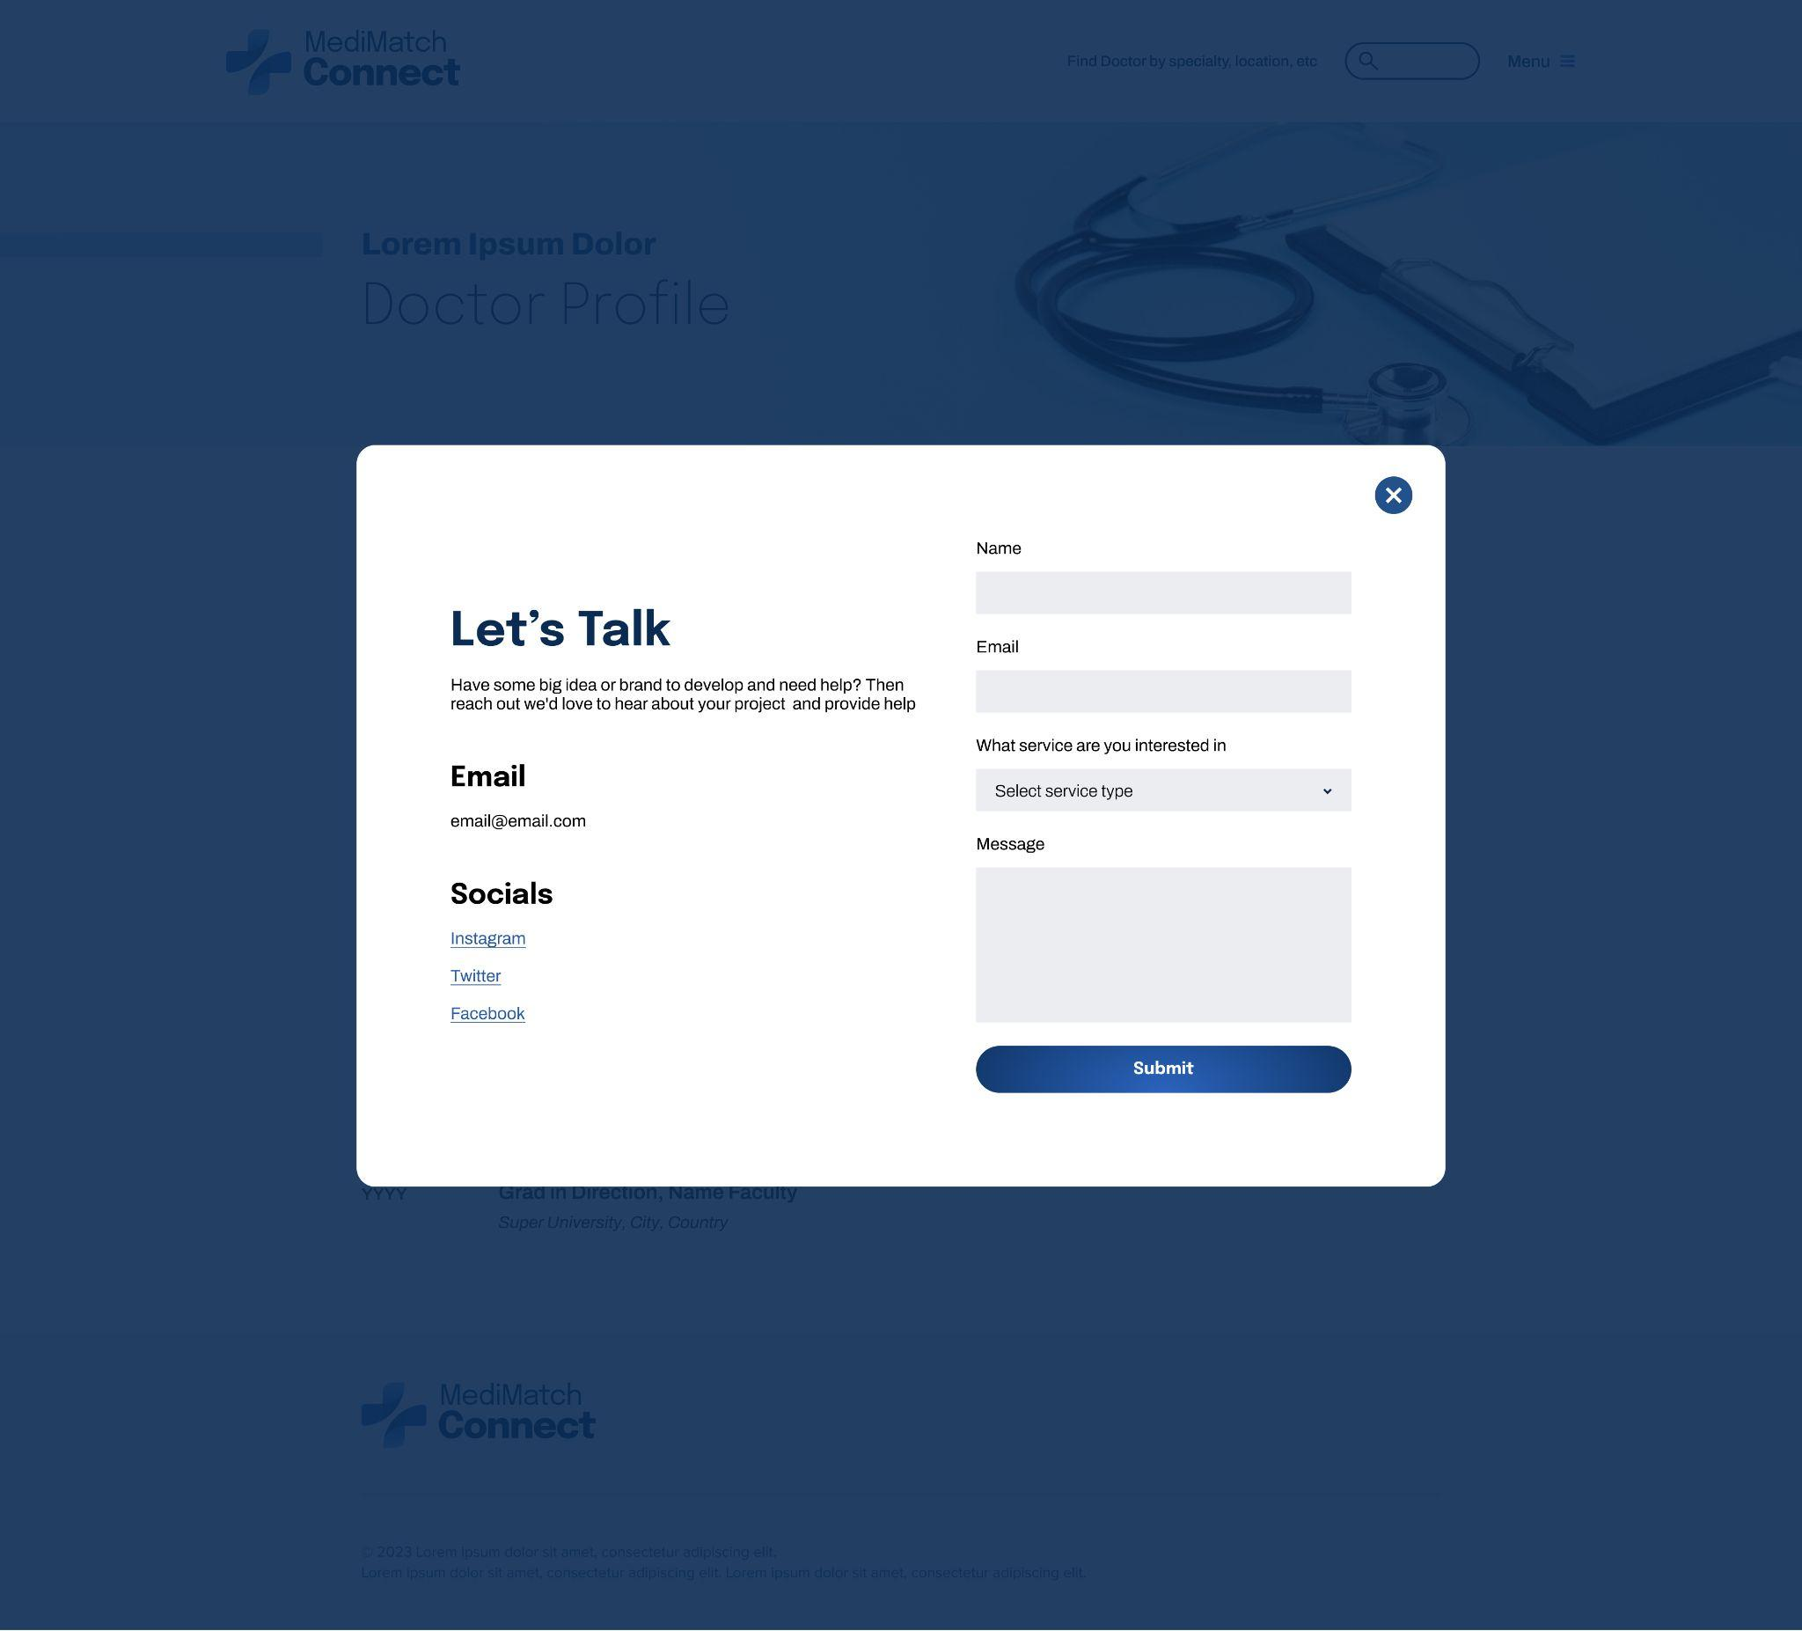
Mockups: Original screen size

Slide 22
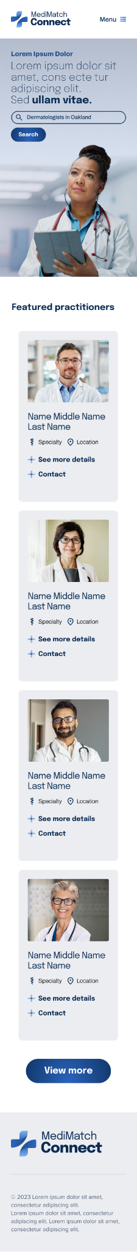
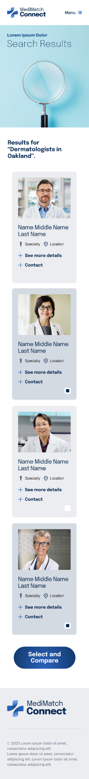
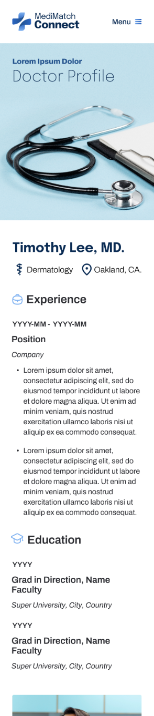
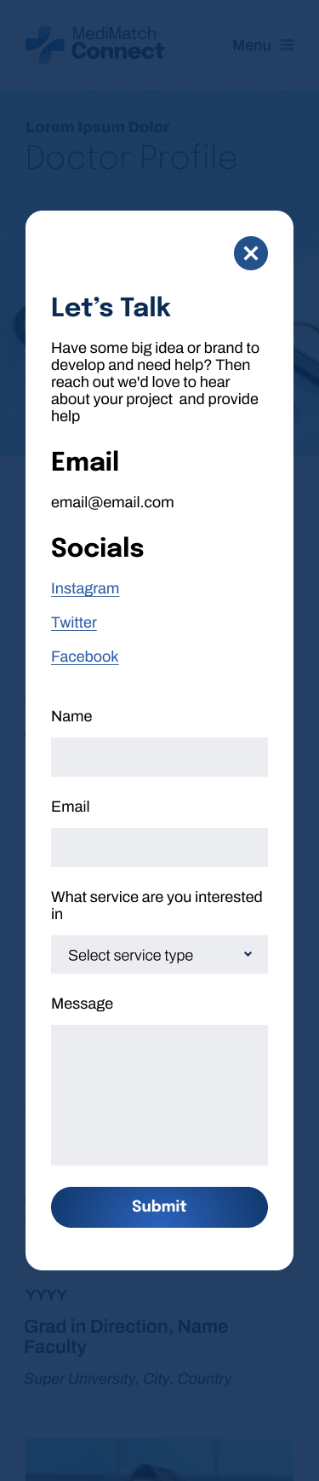
Mockups: Screen size variations

Slide 23
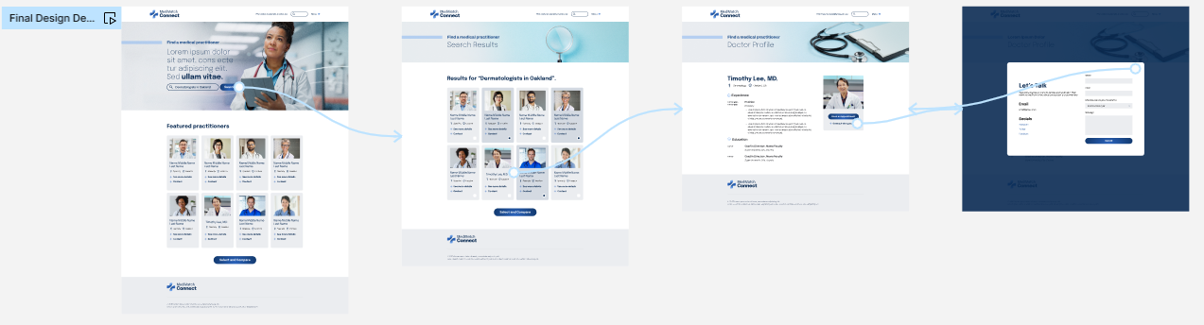
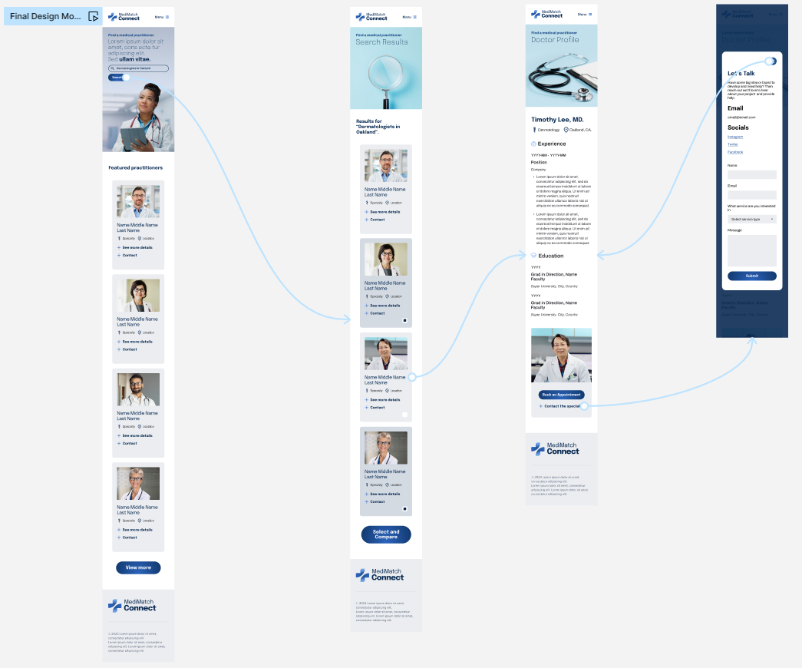
High-fidelity prototype
After finalizing the low-fidelity wireframes, I worked on creating the final designs with the goal of making them simple and intuitive. The main color theme I used was blue to evoke a sense of trust in the users.
View Prototype:
Desktop
Mobile

Slide 24
Accessibility considerations
1
2
3
When choosing a color palette, I made sure my primary colors met WCAG AA Compliance before building out the UI for each screen.
I am using only two typefaces: Epilogue for headlines and Archivo for body copy.
Both are sans serif fonts so they are easy to read.
Mixing too many different typefaces can make your app seem fragmented. It also makes it difficult for the user to know where to look.
I implemented a text hierarchy throughout the app. This helps users to distinguish the different sections and information on screen.

Slide 25
Going forward
Takeaways
Next steps

Slide 26
Takeaways
Impact:
People are still cautious about using digital medical services as health is a crucial aspect of our lives. In an effort to address this issue, I created a platform that offers various features. The design of this platform presents a challenge because the target audience is broad, ranging from ages 18 to 65. To ensure the best possible user experience, it is important to consider the problems faced by users with existing apps and design an app that has a user-friendly interface.
What I learned:
As a UX designer working on a healthcare platform, I have gained valuable insights and knowledge through the design process. Some of the key things I have learned include:
Understanding user needs
Importance of simplicity
Accessibility considerations
User feedback

Slide 27
Next steps
1
2
3
Obtain UX/UI feedback from designers with more experience in the field to improve design.
When I have documented all feedback that was provided, I will make the necessary design updates in order to improve the app’s overall experience.
Create a cross-platform responsive design. The goal is to build the same experience for all users, no matter what type of device they are using.

Slide 28
Let’s connect!
I would appreciate your thoughts and insights on this topic, as feedback is crucial to further enhancing the findings of this study.
Provide your contact information here. This might include your email address, phone number, and website or link to other professional platforms.

